Slide 1



CMP 764 - Next Generation IoT Applications
SMART ENVIRONMENTAL MONITORING SYSTEM WITH NODEMCU AND MQTT
Elif Yağmur Eratalay - N23138404
Refik Can Öztaş - N23131610
Hacettepe University
Computer Engineering MSc

Slide 2
Table Of Content
Introduction
Importence of Solution
01
04
An Introduction to IoT concepts and technologies
Why this solution is important ?
Related Work
Methodology
02
05
Related works in litreature
Setup, implementation and everything
Main Idea of Paper
Results and Discussion
03
06
What is the idea behind this ?
Results

Slide 3
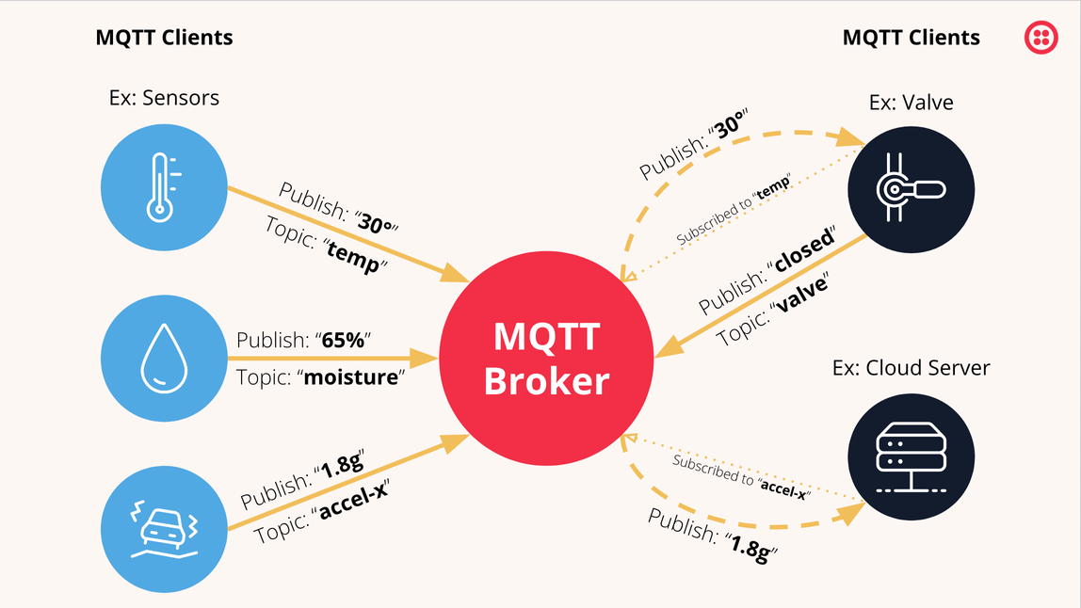

Introduction
The Internet of Things (IoT) is revolutionizing the way we interact with the world around us by enabling devices to communicate, collect, and exchange data. In this project, we aim to develop an IoT application that enhances the monitoring and management of environmental conditions using NodeMCU andDHT11 sensor. Our primary goal is to publish sensor data to a MQTT broker over LAN/Cloud, enabling real-time monitoring and analysis.

Slide 4
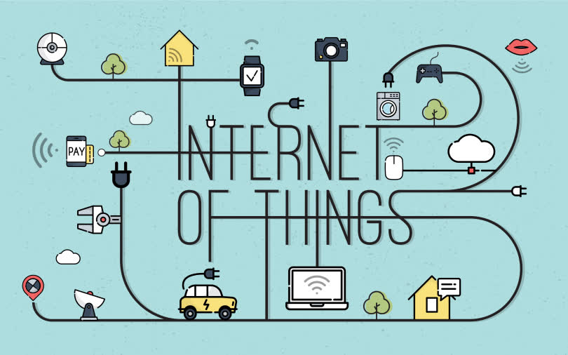
Related Works
Notes:
Device-to-device communications in the Internet of Things are thought to occur via the Pushing or Polling protocols. Push protocol's high productivity and low weight make it more appropriate for Internet of Things devices. For IoT, there are numerous Push protocols available, including XMPP, MQTT, and AMQP, of which MQTT is the most used. MQTT's lightweight and bandwidth efficiency are its salient features.
Security in MQTT relies on username and password authentication, with additional security mechanisms depending on the broker implementation. While brokers often use TLS for security, this can impact performance, particularly in terms of CPU usage during the handshake.
Another study concludes that while the MQTT protocol is suitable for all tested cases, the speed of information transfer is slower than with a serial connection due to reliance on Wi-Fi speed. However, the protocol is reliable and does not lose data when connected to Wi-Fi, as it saves data in a queue.

Slide 5
Main Idea of Paper
This paper presents an IoT application project that focuses on monitoring environmental conditions using NodeMCU and DHT11 sensor. The project involves publishing sensor data to a MQTT broker over LAN/Cloud, visualizing the data on a graph with a history, and integrating a logging system for alarms that functions like a SIEM system. Additionally, the project aims to enhance security by implementing and monitoring various attacks on the system. Through this project, we aim to demonstrate the practical application of IoT technology in environmental monitoring and security enhancement.

Slide 6
Importance of Solution
The IoT application project in the paper addresses key aspects such as environmental monitoring, efficient data transmission, and security. It monitors temperature and humidity levels, aiding early detection of anomalies and hazards. Using the lightweight MQTT protocol ensures real-time data transmission. The project includes a SIEM-like logging system to enhance security by detecting and mitigating threats. By focusing on these areas, the project improves the robustness and resilience of IoT applications, benefiting industries like agriculture, healthcare, and manufacturing.

Slide 7
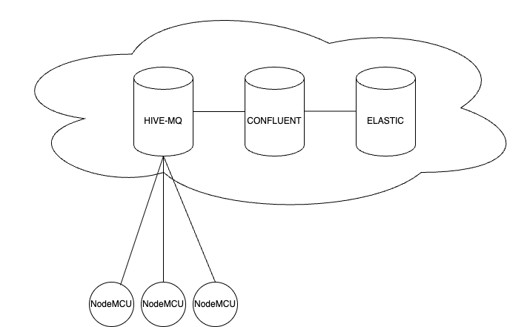
Importance of Solution
proposed system architecture
hivemq for broker
confluent for parsing
elastic for logging

Slide 8
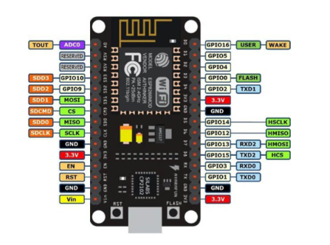
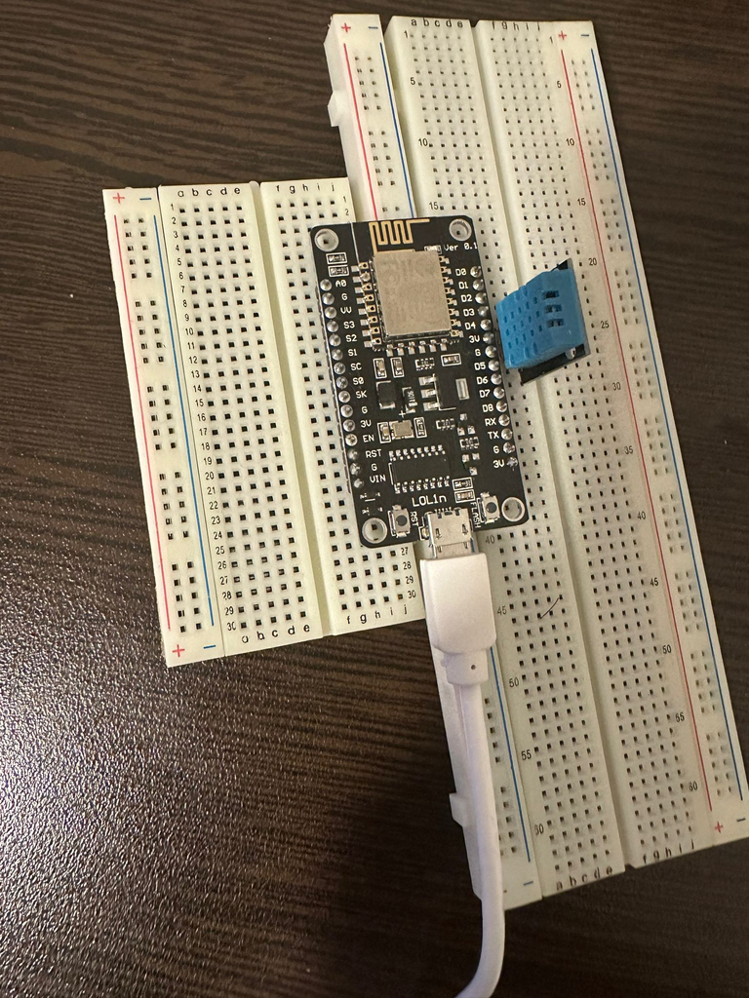
Importance of Solution
proposed hardware
cheap
easy-programmable
uses wi-fi
Notes:
We used NodeMCU ESP8266 because ...

Slide 9
Methodology
I. Hardware Setup
The NodeMCU LoLin ESP8266 Development Board
The NodeMCU LoLin ESP8266 Development Board is a development board that houses an ESP8266 WiFi module with NodeMCU firmware pre-installed. Developed using the ESP8266 SDK, it supports GPIO, PWM, I2C, 1-Wire, and ADC connections without the need for an additional microcontroller.
Breadboard
Breadboard is a tool we use to test our circuits.
DHT11 Temperature and Humidity Sensor
The DHT11 is an advanced sensor unit that provides calibrated digital signal output for temperature and humidity detection. It is highly reliable and stable for long-term operations. It measures temperature with an accuracy of ±2°C within the range of 0 to 50°C.
Notes:
You can see the hardware set up of our project here.

Slide 10
Methodology
II. Software Setup
We demonstrated the process of publishing DHT11 sensor data from NodeMCU to an MQTT broker for consumption by an MQTT client. Although we utilized a DHT11 sensor in this instance, any sensor could be substituted for testing purposes.
Connection Diagram: The GPIO 2 pin was connected to the DHT11 sensor. The Arduino code was then configured accordingly. Given the DHT sensor's type was DHT11, users were required to input their Wi-Fi SSID and password for connection. The MQTT server's IP address was also specified; in this case, we used the system's IP address as the MQTT server. To find the system's IP address, users were instructed to open the command prompt and type ipconfig.
Various topics were defined for sensor values, with the main topic labeled as 'sensor,' and subtopics including DHT11 sensor type, humidity, temperature, and Fahrenheit.

Slide 11
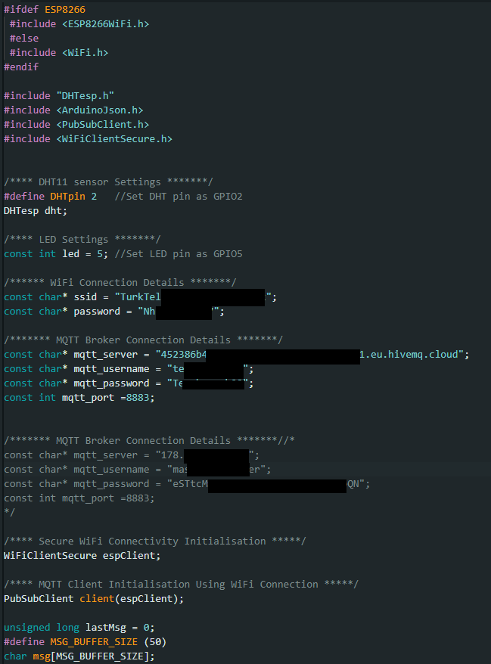
CODE
Notes:
We determine HiveMQ as our MQTT broker. Also determine this server's username and password. Than we used MQTT Explorer for interact with the MQTT broker.

Slide 12
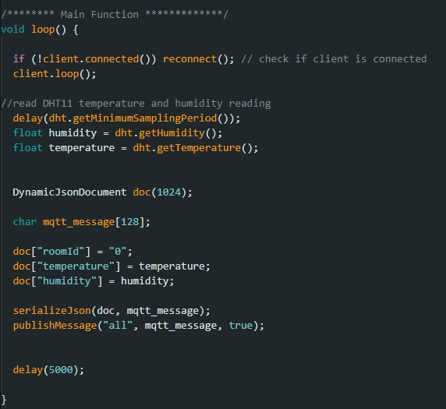
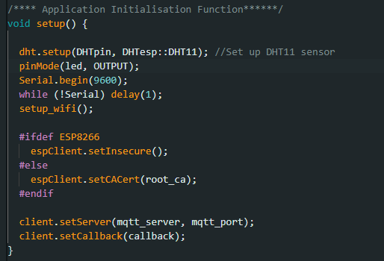
CODE

Slide 13
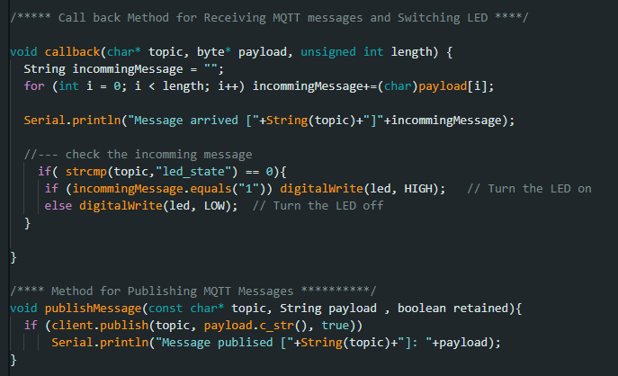
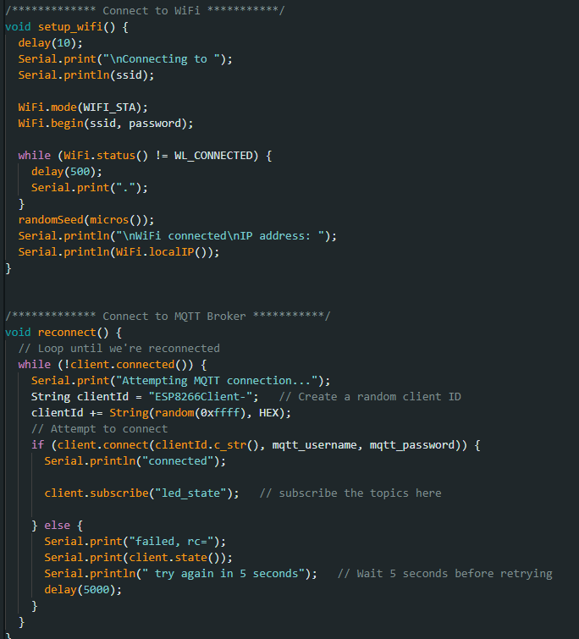
CODE

Slide 14
Methodology
III. MQTT Broker Configuration
Following the Wi-Fi setup, we specified the MQTT broker's port number, which may vary when connecting to a Cloud MQTT broker.
Sensor values were read and published to the MQTT broker, with the temperature in Celsius, temperature in Fahrenheit, and humidity. These values were published to the local Mosquitto broker, where they could be accessed by another client.
Finally, the NodeMCU was connected to the system and the code was uploaded. The sensor values could be monitored through the serial monitor.
MQTT Explorer is another application that was used to interact with the MQTT broker in the project. To specify the IP address of the Mosquitto broker, the user first connected by entering the IP address and port number. It was also necessary to provide a password in some configurations. To establish communication between the user's IP address and localhost, ports sometimes needed to be forwarded from the LAN IP to the local IP.

Slide 15
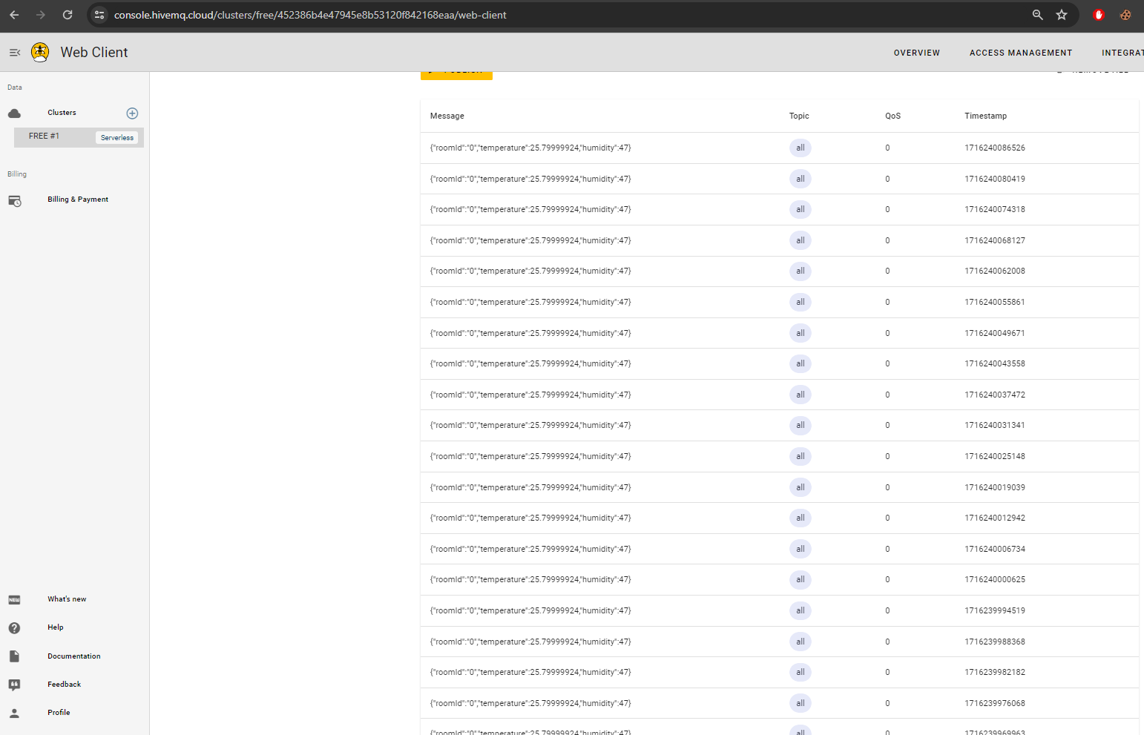
Methodology
HiveMQ
Notes:
You can see our MQTT broker's interface and the data flow here.

Slide 16
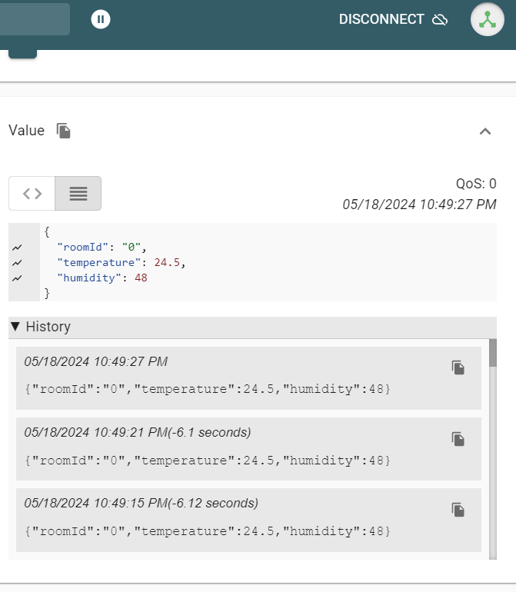
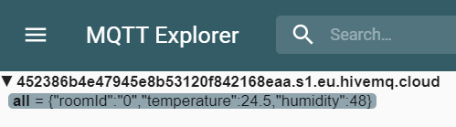
Notes:
You can see the MQTT Explorer Application here.

Slide 17
Methodology
IV. Data Publishing and Downloading
Once the NodeMCU was connected to the Mosquitto broker, it started publishing data. In MQTT Explorer, selecting a topic allowed users to view a graph showing the history of that topic's data.
Confluent Cloud is a cloud service based on Apache Kafka. It allows users to use Kafka in cloud environments and manages the infrastructure and management tasks required to operate Kafka. This allows us to quickly start using Kafka and run their applications on Kafka. It typically offers advantages such as high scalability, reliability, and ease of use.
We uploaded our data to Kafka Confluent Cloud and subsequently were able to download it in CSV or JSON format using HiveMQ.

Slide 18
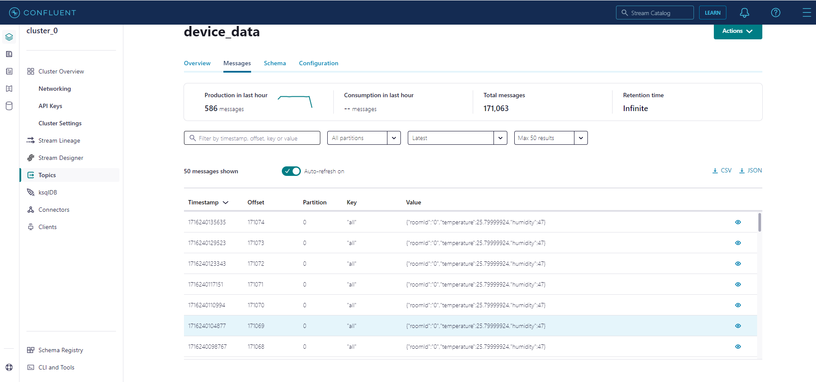
Methodology
IV. Data Publishing and Downloading
Notes:
Here you can see Kafka Confluent Cloud interface here. We download our data from here in CSV and JSON format for visualization.

Slide 19
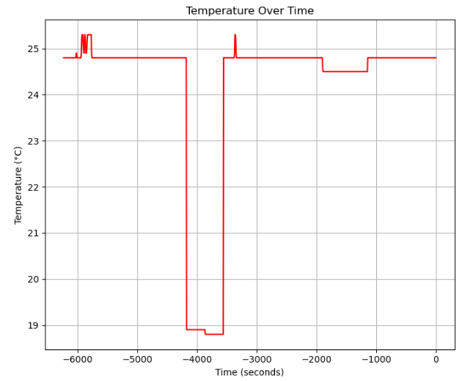
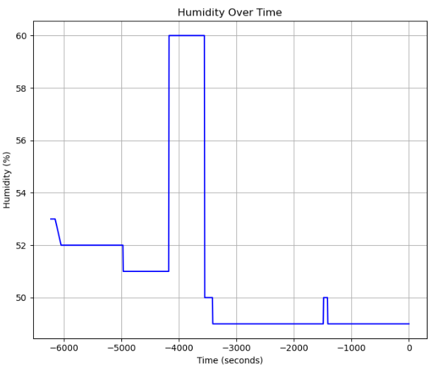
Methodology
V. Data Visualization
A dataset comprising 1000 rows with information such as temperature, humidity, date, and time has been collected. This data covers the period from May 18, 18:43:16 GMT+3 to May 18, 20:27:06 GMT+3. During the offsets between 140200 and 140300 (10 minutes), the device was located on an exterior-facing balcony. At other times, it was placed indoors. The following graphs illustrate the data using various visualization techniques.
Notes:
Here you can see the changes in temperature and humidity over a 2 hour period and the changes over a 10 minute stay outdoors. During this time, the temperature decreased and the humidity increased.

Slide 20
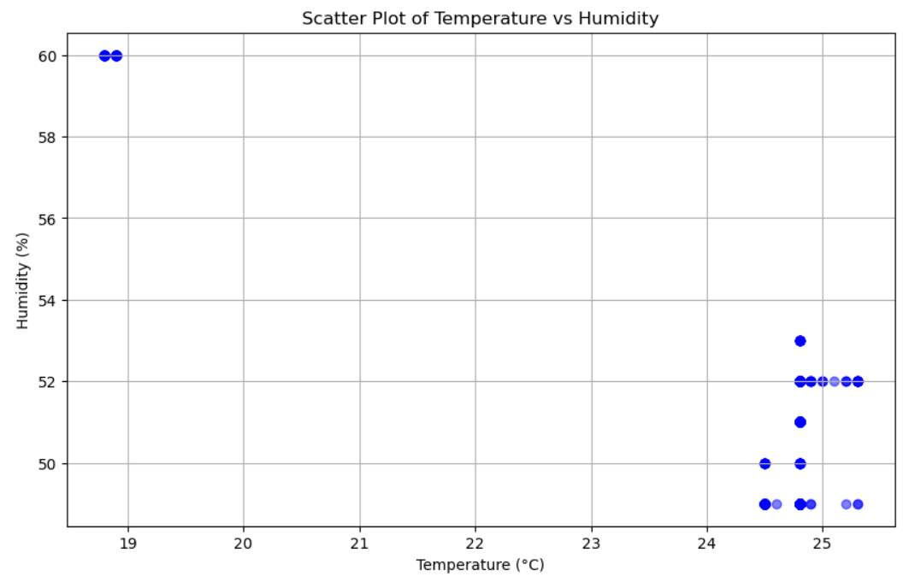
The scatter plot illustrates the relationship between temperature and humidity over the specified time period. Each point on the plot represents a data entry with its corresponding temperature and humidity values. This visualization allows for the identification of patterns and correlations between the two variables. Also, clusters of points may indicate consistent conditions, while outliers could suggest anomalies or changes in the environment.

Slide 21
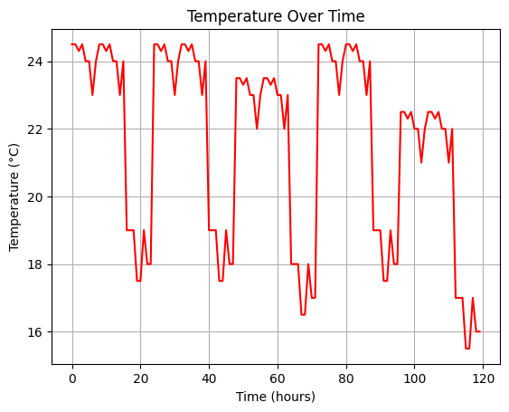
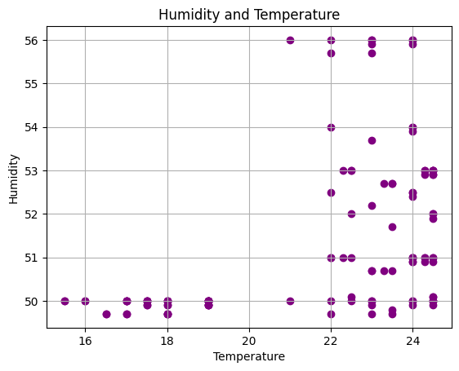
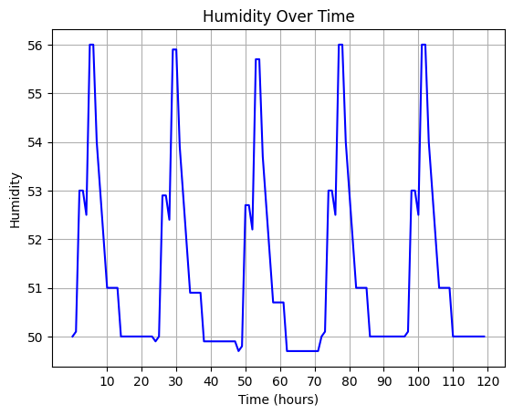
Subsequently, we adjusted the logging intervals of the device and utilized a dataset spanning 120 hours. The resulting graphs, presented below, illustrate our findings. This approach enabled us to observe the variations in temperature and humidity between day and night on a daily basis.
Notes:
In the temperature over time graph you can see that the temperature during the day was 25-26 degrees and at night it was 18-16 degrees for 5 days.
The humidity fluctuated periodically between 50-56 for 5 days.
In the third graph you can see the scatter plot where the humidity and temperature values are shown together.

Slide 22
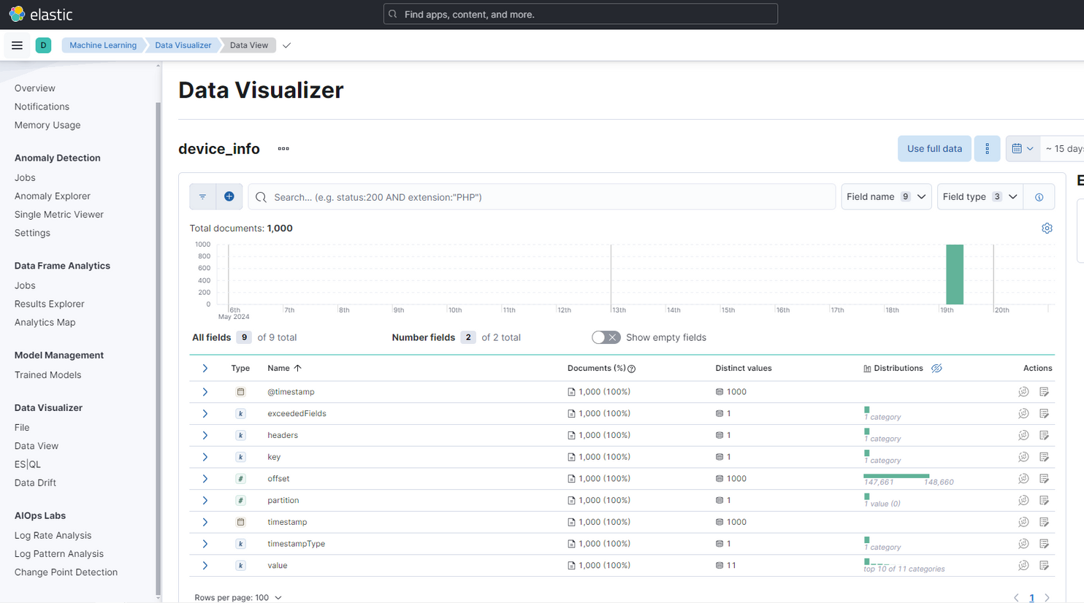
VI. SIEM
We set up a Security Information and Event Management (SIEM) system using the Elastic Stack on Elastic Cloud. Next, we create a Elastic account, deploy Elasticsearch, and configure it. We then describe the installation of the Elastic agent on the Cloud and the generation of security events using Nmap. Additionally, we visualize data from the Machine Learning/Visualization section. Furthermore, we cover querying and analyzing logs in Elastic SIEM, creating a dashboard to visualize security events. This provides practical insights for implementing a SIEM solution using the Elastic Stack, enhancing cybersecurity monitoring and incident response capabilities.

Slide 23
Methodology
VII. Security
Since security is one of the most important concern in IoT networks, we have used some features to enhance security:
IoT clients use TLS certificates in order to communicate with HiveMQ. Therefore, traffic is encrypted and resilient against Man-in-the-Middle attacks
We used username password based authentication when communicating with MQTT broker. We chose strong password and username which is alpha-numerical with special characters and minimum 12 length.
We extracted hardcoded passwords from .ino file to .h file, which is very much difficult to reverse in arduino hardware.
Data format is strict in Confluent server, that means that if data comes that does not match the pattern in MQTT it will generate an alarm.
We logged everything in elastic, if an incident happens, that can be solved via Elastic.

Slide 24
Results and Discussion
In this project, we successfully developed a Smart Environmental Monitoring System using NodeMCU and DHT11 sensor, demonstrating the practical application of IoT technology in environmental monitoring and security enhancement. By publishing sensor data to a Mosquitto MQTT broker and visualizing the data on graphs with historical context, we provided a comprehensive solution for real-time monitoring and analysis of environmental conditions.
Our integration of a logging system functioning as a Security Information and Event Management (SIEM) system significantly enhanced the security and reliability of the application. The system's capability to detect and mitigate potential security threats ensures the integrity and confidentiality of the collected data. Moreover, by implementing and monitoring various attacks, we identified potential vulnerabilities and strengthened the system's resilience against cyber threats.
The project's emphasis on the MQTT protocol for data transmission underscored its suitability for IoT applications due to its lightweight nature and efficiency in communication. The use of TLS certificates and strong authentication mechanisms further secured the communication channels, making the system robust against potential cyber-attacks.

Slide 25
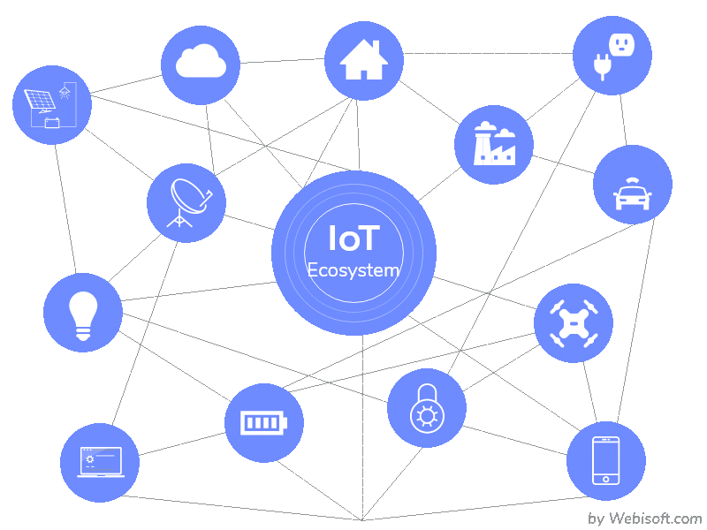
Thank You!

